Slide 1
William Stallings
Computer Organization and Architecture
7th Edition
Chapter 7
Input/Output

Slide 2
Input/Output Problems
Wide variety of peripherals
  Delivering different amounts of data
  At different speeds
  In different formats
All slower than CPU and RAM
Need I/O modules

Slide 3
Input/Output Module
Interface to CPU and Memory
Interface to one or more peripherals

Slide 4
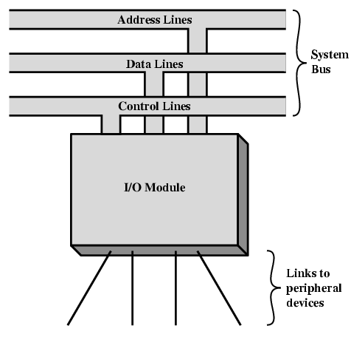
Generic Model of I/O Module

Slide 5
External Devices
Human readable
  Screen, printer, keyboard
Machine readable
  Monitoring and control
Communication
  Modem
  Network Interface Card (NIC)

Slide 6
I/O Steps
CPU checks I/O module device status
I/O module returns status
If ready, CPU requests data transfer
I/O module gets data from device
I/O module transfers data to CPU
Variations for output, DMA, etc.

Slide 7
Input Output Techniques
Programmed
Interrupt driven
Direct Memory Access (DMA)

Slide 8
PROGRAMMED I/O
Data transfer operations are completely controlled by CPU i.e. CPU executes a program that initiates, directs and terminates the I/O operation

Slide 9
PROGRAMMED I/O
Useful where h/w costs need to be minimized.
Entire I/O is handled by CPU
STEPS
  1. Read I/O devices status bit
  2. Test status bit to determine if device is ready
  3. If device not ready return to step 1
  4. During interval when device is not ready CPU simply wastes its time until device is ready

Slide 10
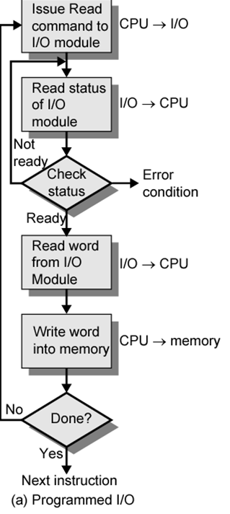

Slide 11
INTERRUPT DRIVEN I/O
Major drawback of programmed I/O is busy waiting
Speed of I/O devices is much slower than CPU
Performance of CPU goes down as it has to repeatedly check for device status
Solution: Switch to another task if device is not ready and thus use interrupt mechanism

Slide 12
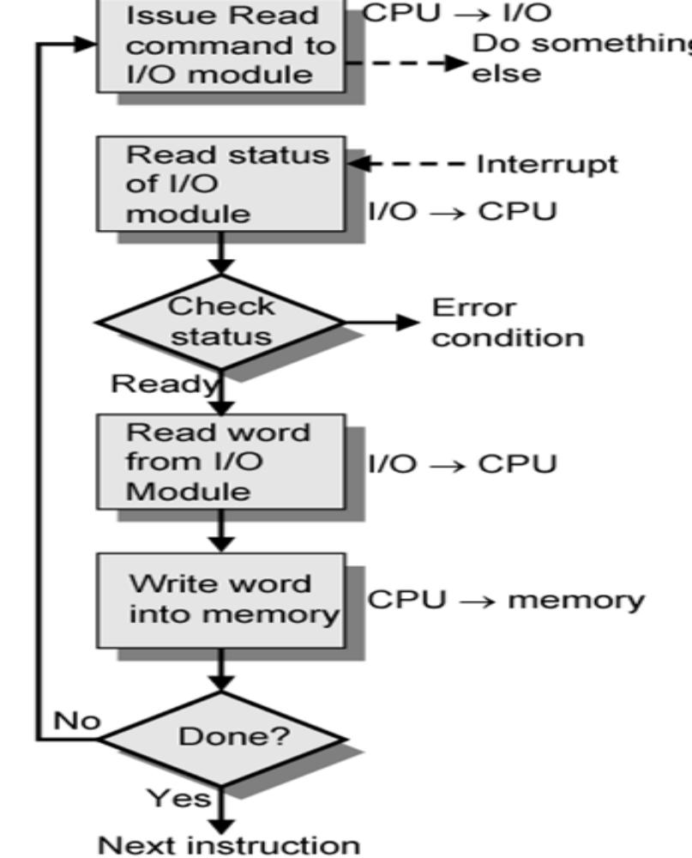

Slide 13
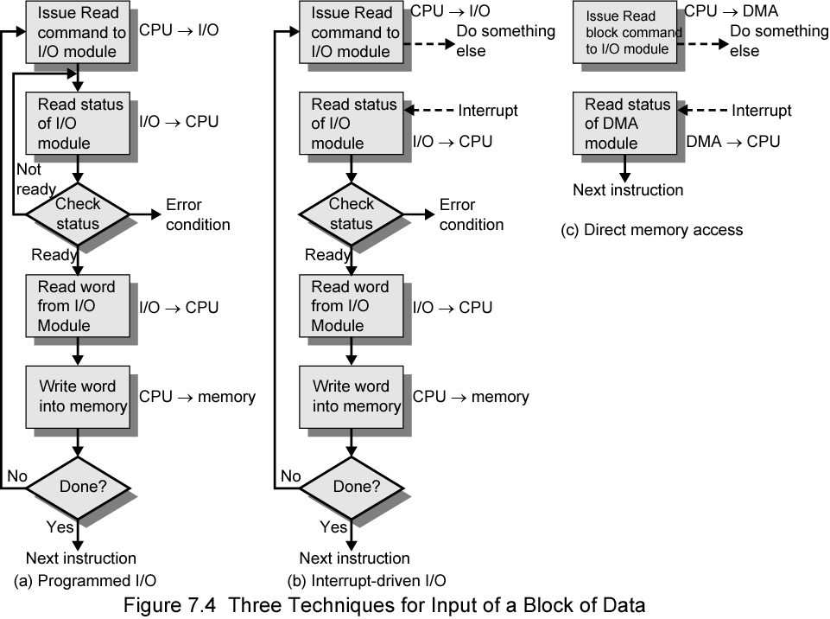
Three Techniques for
Input of a Block of Data

Slide 14
Programmed I/O
CPU has direct control over I/O
  Sensing status
  Read/write commands
  Transferring data
CPU waits for I/O module to complete operation
Wastes CPU time

Slide 15
Programmed I/O - detail
CPU requests I/O operation
I/O module performs operation
I/O module sets status bits
CPU checks status bits periodically
I/O module does not inform CPU directly
I/O module does not interrupt CPU
CPU may wait or come back later

Slide 16
Interrupt Driven I/O
Overcomes CPU waiting
No repeated CPU checking of device
I/O module interrupts when ready

Slide 17
Interrupt Driven I/O
Basic Operation
CPU issues read command
I/O module gets data from peripheral whilst CPU does other work
I/O module interrupts CPU
CPU requests data
I/O module transfers data

Slide 18
CPU Viewpoint
Issue read command
Do other work
Check for interrupt at end of each instruction cycle
If interrupted:-
  Save context (registers)
  Process interrupt
    Fetch data & store
See Operating Systems notes

Slide 19
Direct Memory Access
Interrupt driven and programmed I/O require active CPU intervention
  Transfer rate is limited
  CPU is tied up
Direct memory access (DMA) is a feature of computer systems that allows certain hardware subsystems to access main system memory (RAM) independently of the central processing unit (CPU).

Slide 20
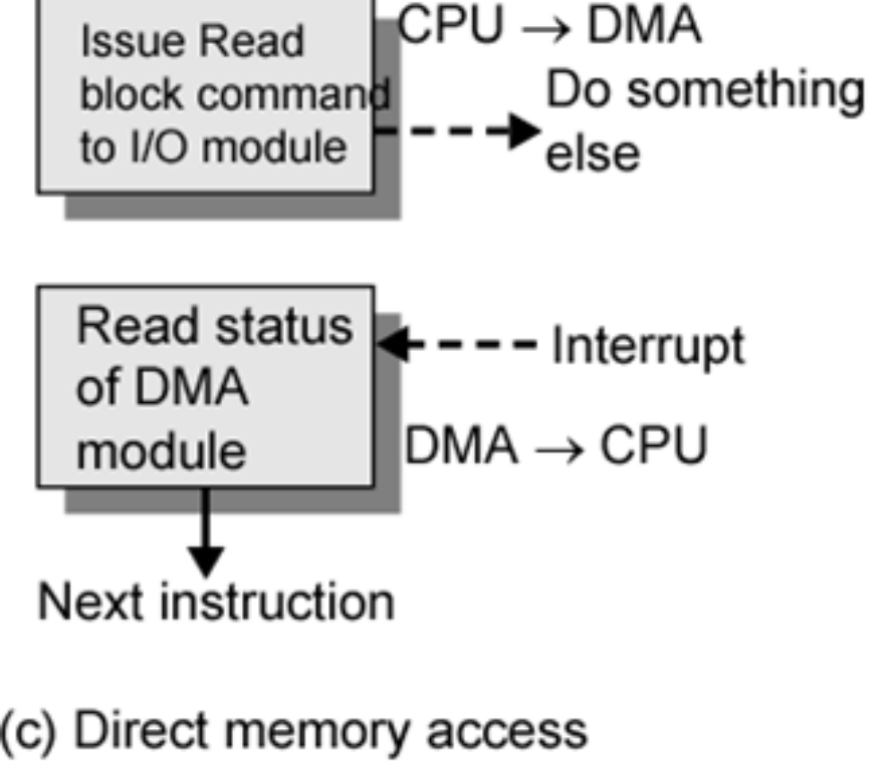
DMA Function
Additional Module (hardware) on bus
DMA controller takes over from CPU for I/O

Slide 21
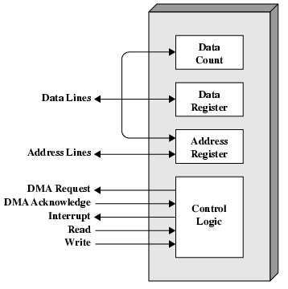
Typical DMA Module Diagram

Slide 22
DMA Operation
CPU tells DMA controller:-
  Read/Write
  Device address
  Starting address of memory block for data
  Amount of data to be transferred
CPU carries on with other work
DMA controller deals with transfer
DMA controller sends interrupt when finished

